Slide 1
Organizational Behavior
Professional Development Series: Session 1

Slide 2
Appropriate and Productive Relationships (1 min)
Establishing and maintaining appropriate and productive relationships is important in both your personal and professional lives. Your ability to do this depends on accurately assessing situations that require you to engage with others in a manner that is suitable for the context and the person or persons involved.
Understanding how to develop and maintain relationships is a key component for success, socially and professionally. Think about all of the things you are involved in at Purdue that require engaging with others. Your success and satisfaction in each situation depend on the quality of the relationships you create and maintain.
*Content developed by the Roger C. Stewart Leadership and Professional Development Department: https://www.purdue.edu/vpsl/leadership/

Slide 3
Discussion (5 minutes)
Do you feel that your relationships with your personal friends differ from your relationships with peers in the classroom or in a student organization? How so?
Do you feel that you intentionally engage with others in a manner suitable for the context? Have you ever reflected on this before?
How do you feel appropriate and productive relationships affect professionalism and success?
*Content developed by the Roger C. Stewart Leadership and Professional Development Department: https://www.purdue.edu/vpsl/leadership/

Slide 4
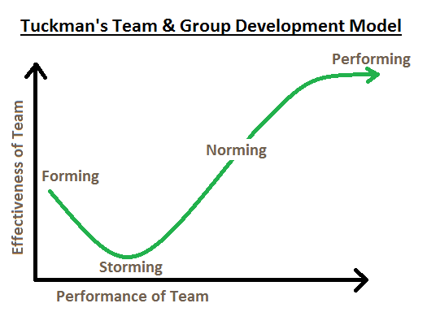
Forming, Storming, Norming, Performing
The forming–storming–norming–performing model of group development was first proposed by Bruce Tuckman in 1965,^{[1]} who said that these phases are all necessary and inevitable in order for a team to grow, face up to challenges, tackle problems, find solutions, plan work, and deliver results.

Slide 5
Forming
The team meets and learns about the opportunities and challenges, and then agrees on goals and begins to tackle the tasks. Team members tend to behave quite independently. They may be motivated but are usually relatively uninformed of the issues and objectives of the team. Team members are usually on their best behavior but very focused on themselves. Mature team members begin to model appropriate behavior even at this early phase.
The meeting environment also plays an important role to model the initial behavior of each individual. The major task functions also concern orientation. Members attempt to become oriented to the tasks as well as to one another.
This is also the stage in which group members test boundaries, create ground rules, and define organizational standards. Discussion centers on defining the scope of the task, how to approach it, and similar concerns. To grow from this stage to the next, each member must relinquish the comfort of non-threatening topics and risk the possibility of conflict .

Slide 6
Storming
This is the second stage of team development, where the group starts to sort itself out and gain each others' trust. This stage often starts when they voice their opinions; conflict may arise between team members as power and status are assigned. When group members start to work with each other they start to learn about individual working styles and what it is like to work with each other as a team; it also identifies the hierarchy of positions in the group.
At this stage there is often a positive and polite atmosphere, people are pleasant to each other, and they may have feelings of excitement, eagerness and positiveness. Others may have feelings of suspicion, fear and anxiety. The leader of the team will then describe the tasks to the group, describe the different behaviors to the group and how to deal and handle complaints.
In this stage participants form opinions about the character and integrity of the other participants and feel compelled to voice these opinions if they find someone shirking responsibility or attempting to dominate. Sometimes participants question the actions or decision of the leader as the expedition grows harder. Disagreements and personality clashes must be resolved before the team can progress out of this stage, and so some teams may never emerge from "storming” or re-enter that phase if new challenges or disputes arise.

Slide 7
Norming
Resolved disagreements and personality clashes result in greater intimacy, and a spirit of co-operation emerges. This happens when the team is aware of competition, and they share a common goal.
In this stage, all team members take responsibility and have the ambition to work for the success of the team's goals. They start tolerating the whims and fancies of the other team members. They accept others as they are and make an effort to move on. The danger here is that members may be so focused on preventing conflict that they are reluctant to share controversial ideas.

Slide 8
Norming
With group norms and roles established, group members focus on achieving common goals, often reaching an unexpectedly high level of success. By this time, they are motivated and knowledgeable. The team members are now competent, autonomous and able to handle the decision-making process without supervision. Dissent is expected and allowed as long as it is channeled through means acceptable to the team.
Supervisors of the team during this phase are almost always participating. The team will make most of the necessary decisions. Even the most high-performing teams will revert to earlier stages in certain circumstances. Many long-standing teams go through these cycles many times as they react to changing circumstances. For example, a change in leadership may cause the team to revert to storming as the new people challenge the existing norms and dynamics of the team.

Slide 9
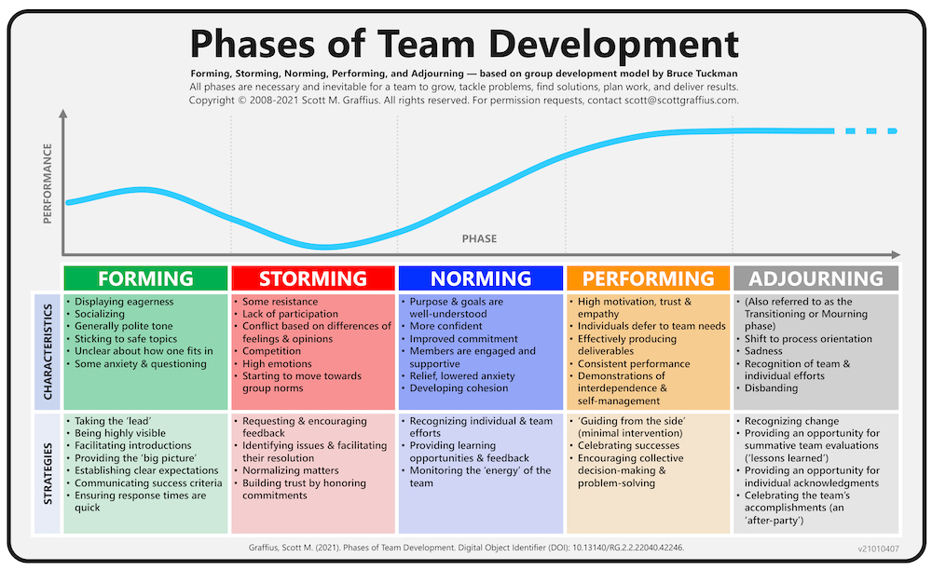
Summary

